Slide 1
Python Pandas
ALTERING DATAFRAME IN PYTHON PANDAS

Slide 2
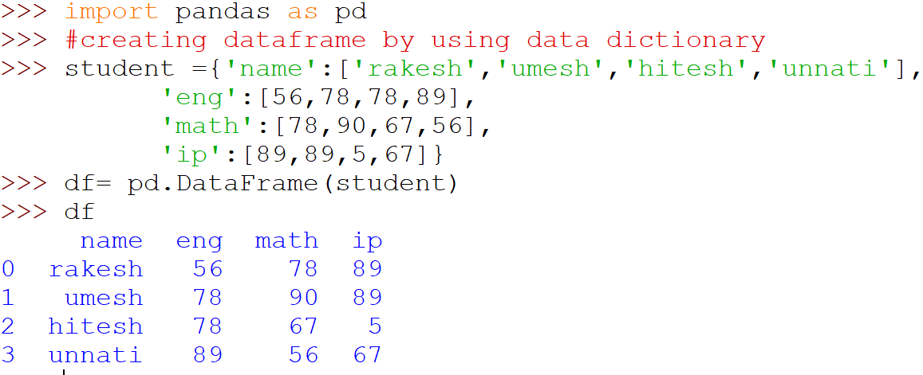
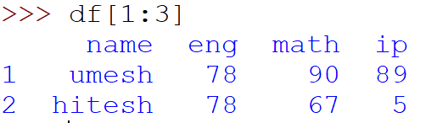
DataFrame creation
#accessing dataframe using default index ---- slicing
Slicing using default Index

Slide 3
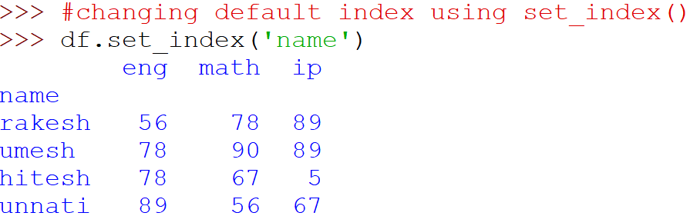
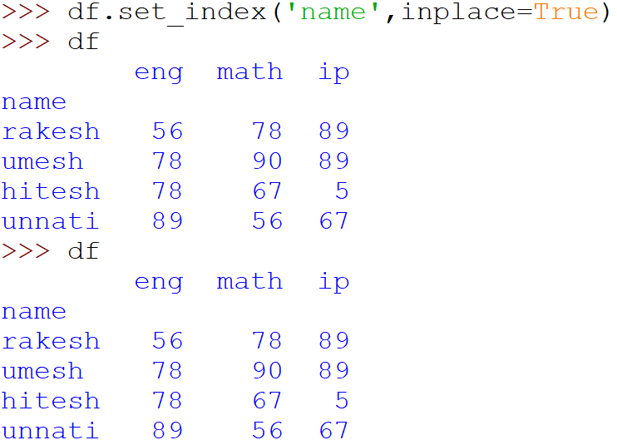
Changing default index
It only display the newly generated index but does not hold values in the same dataframe
Inplace = True will make name as your new index and make changes in current DataFrame

Slide 4
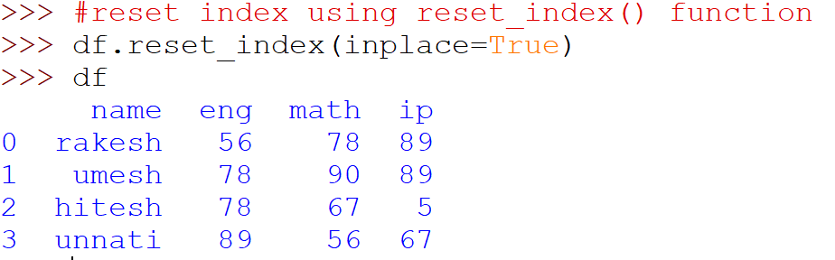
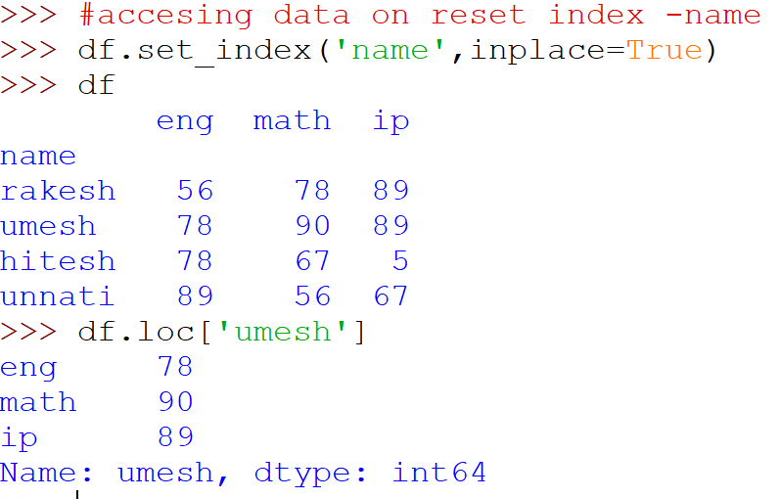
Inplace =True is compulsory to make changes in current DataFrame
DataFrame.loc[] attribute is only available with different index when set other than default

Slide 5
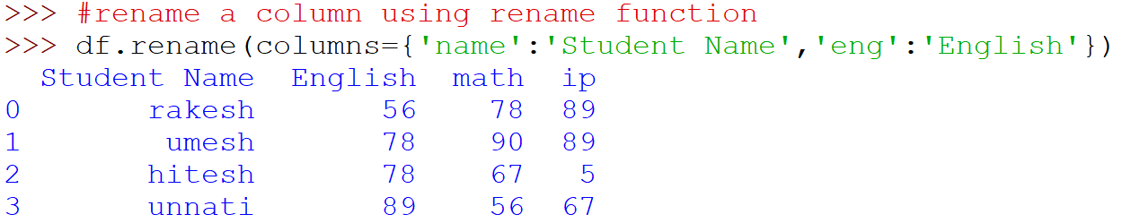
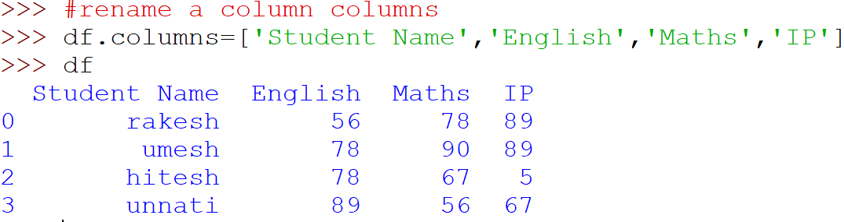
Rename columns in DataFrame
Rename function does not make changes in the current DataFrame
.columns make columns name permanent

Slide 6
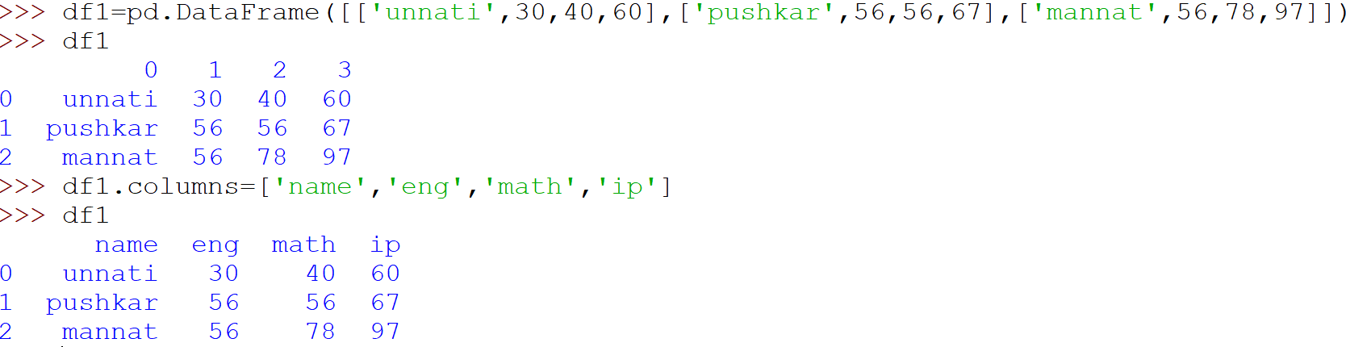
Renaming column name--- continue

Slide 7
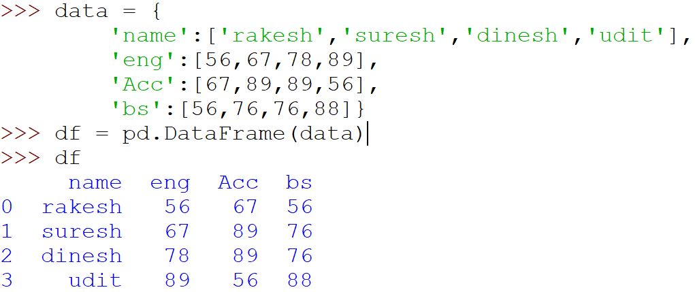
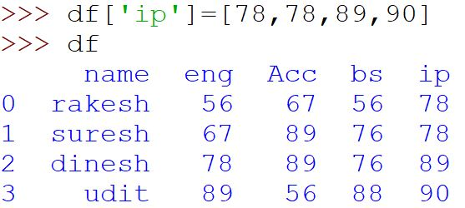
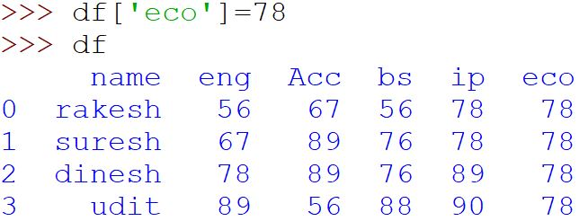
Altering DataFrame’s Data ( Adding a New Column )
Added new column ‘IP’ with values
Assign all the rows as 78

Slide 8
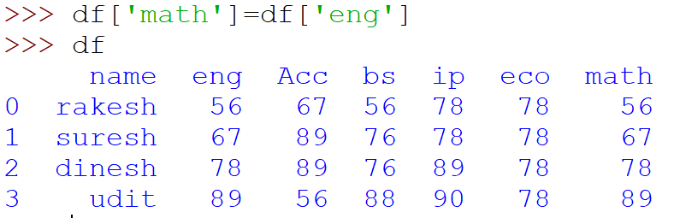
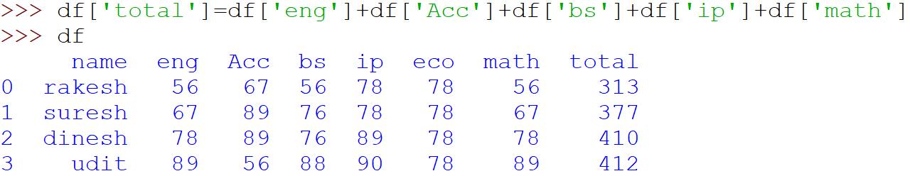
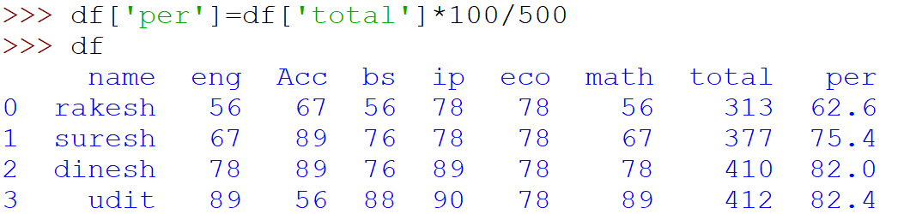
Adding a New column in DataFrame
Adding a column using another column
Adding column using simple math operator

Slide 9
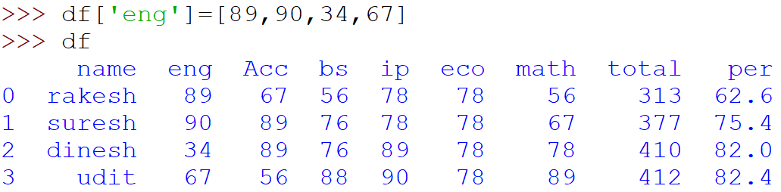
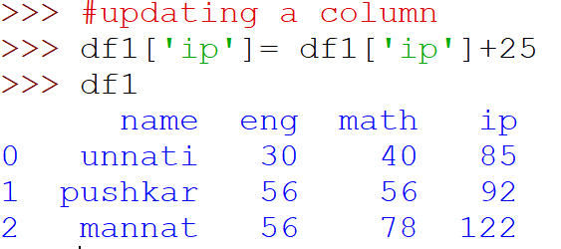
Adding column in DataFrame
Replace values in the column if ‘column already exists’

Slide 10
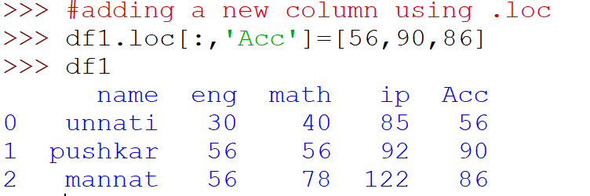
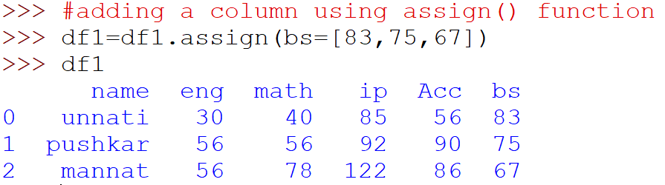
Adding a New column using index

Slide 11
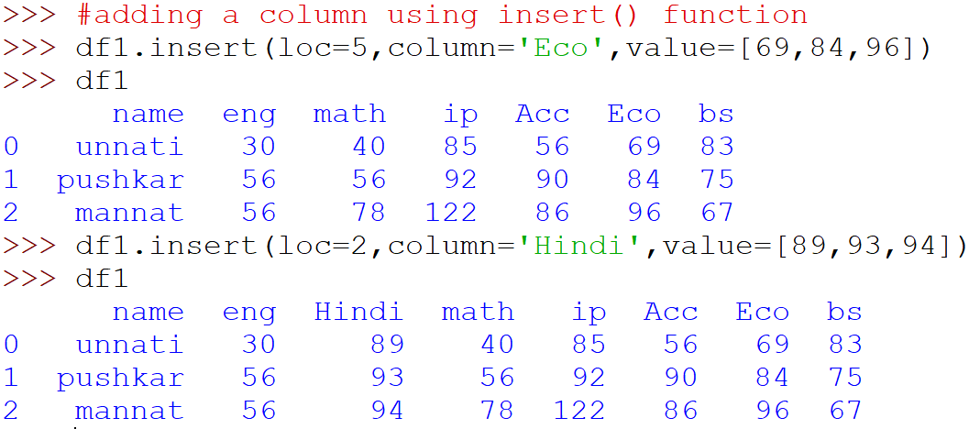
Adding a column using insert function
If column already exist at that position then it will shift all the other columns at right hand side

Slide 12
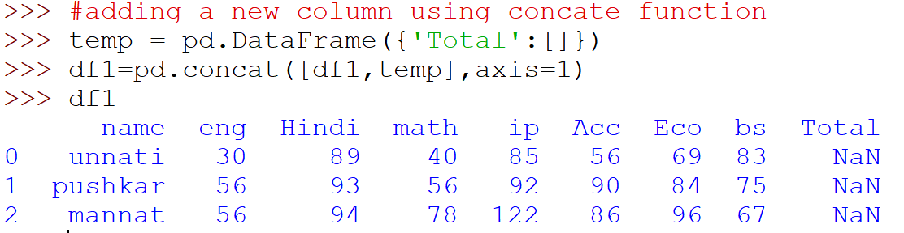
Adding a New column using Concat() Function
Empty DataFrame is added thus NaN value
NaN - Means Values does not exists at this position

Slide 13
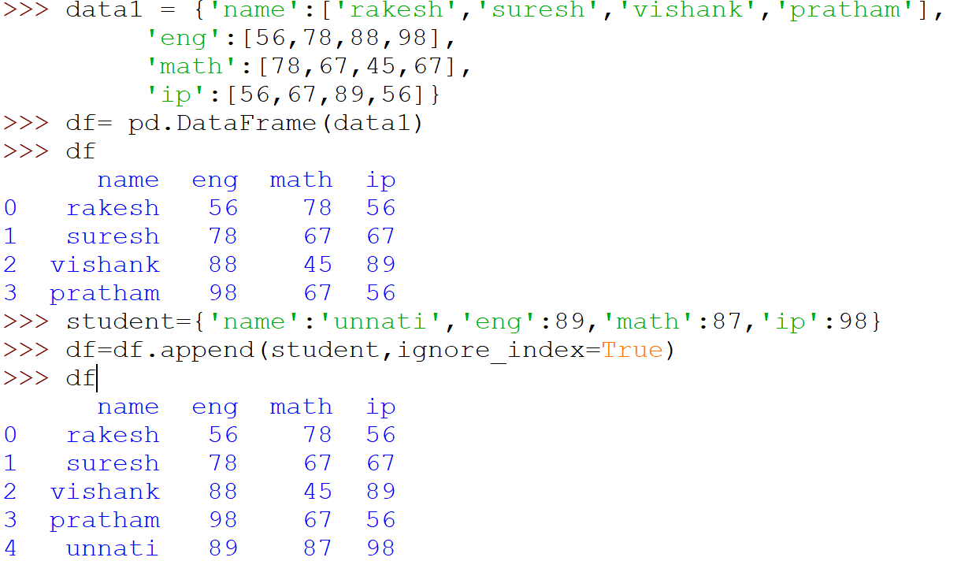
Adding a Row in DataFrame

Slide 14
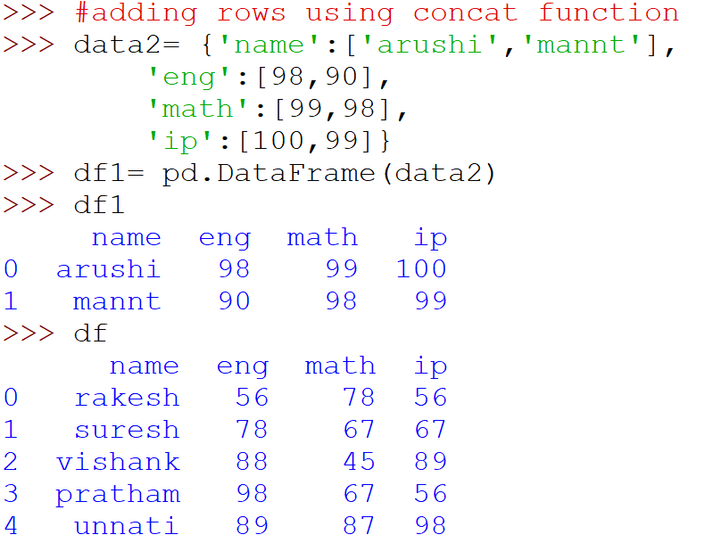
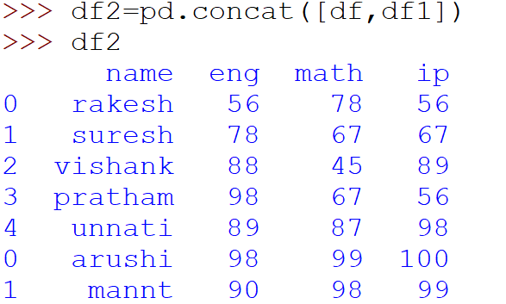
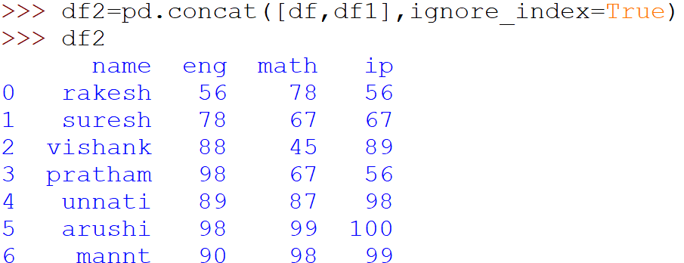
Adding a new row using concat() function

Slide 15
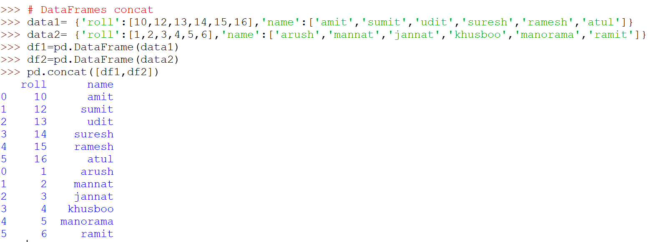
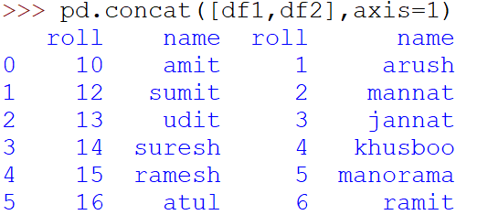
Concat function
When Axis is not defined it will append data in the first DataFrame ie add data in rows

Slide 16
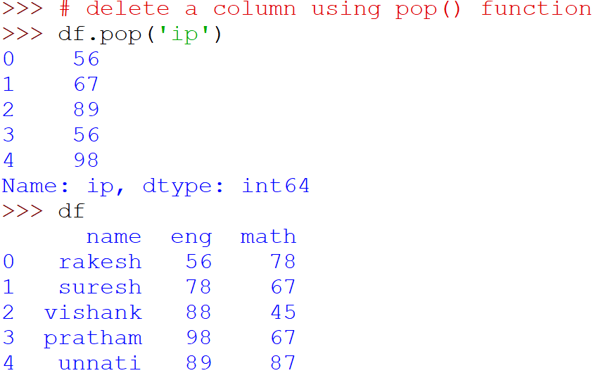
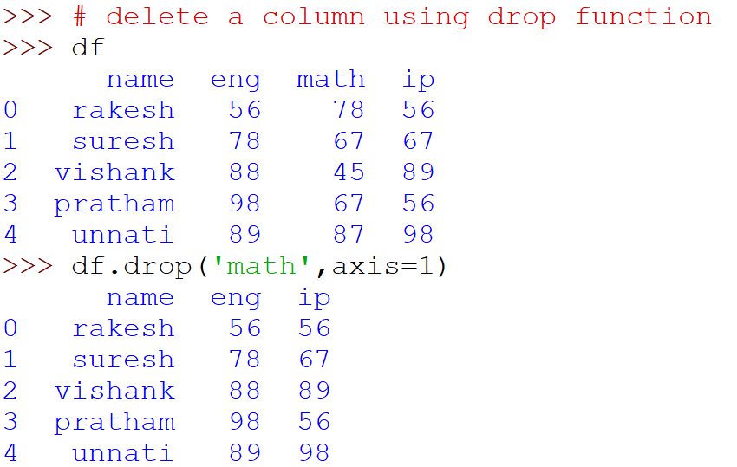
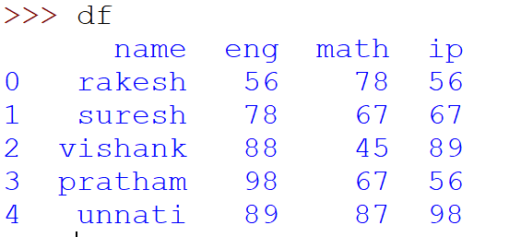
Deleting a Column
Pop function return the deleted column with its values
Drop() function delete the column but does not store the result in current dataFrame

Slide 17
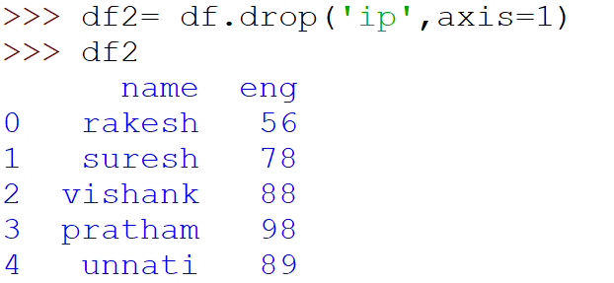
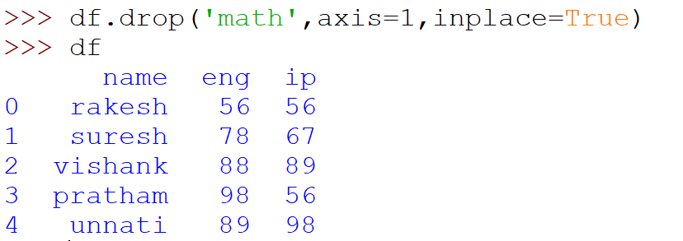
Delete a column from DataFrame

Slide 18
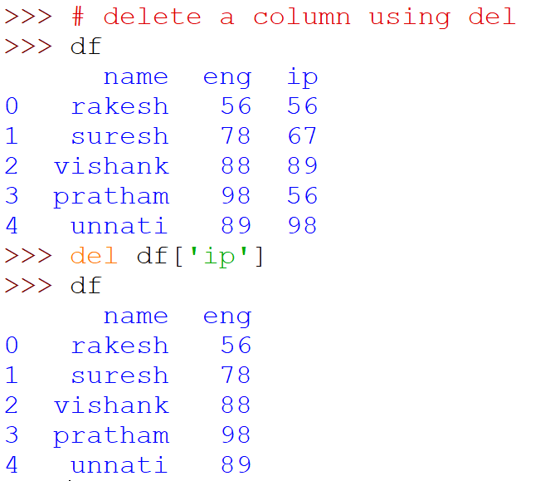
Delete a column using del

Slide 19
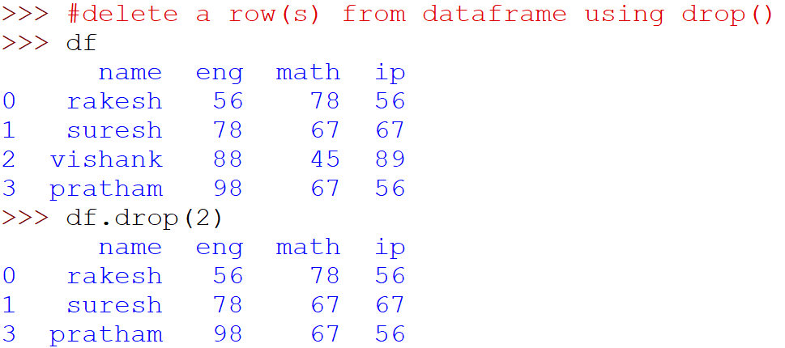
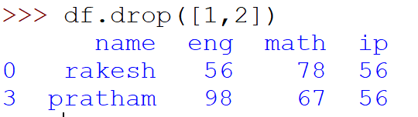
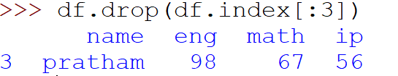
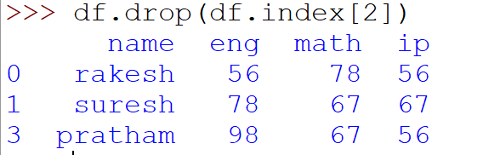
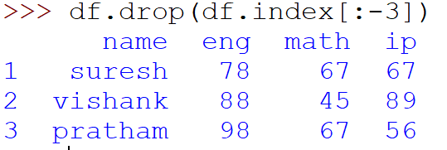
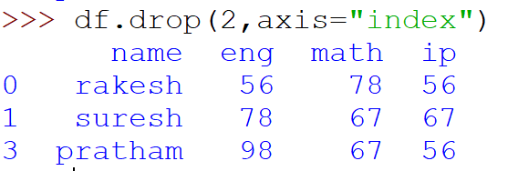
Delete a Row- using Drop()
Delete all except last 3 entries

Slide 20
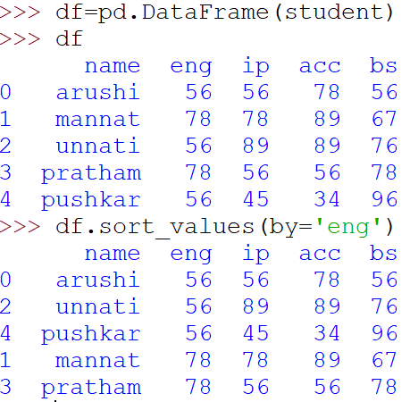
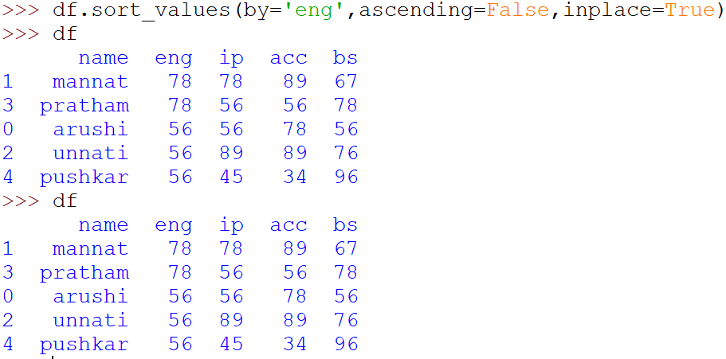
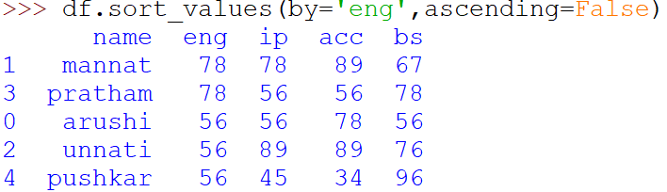
Sort Values

Slide 21
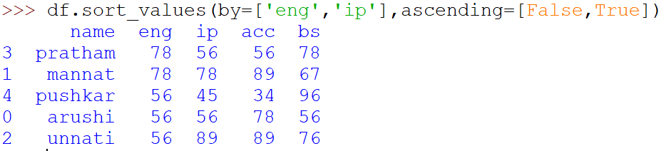
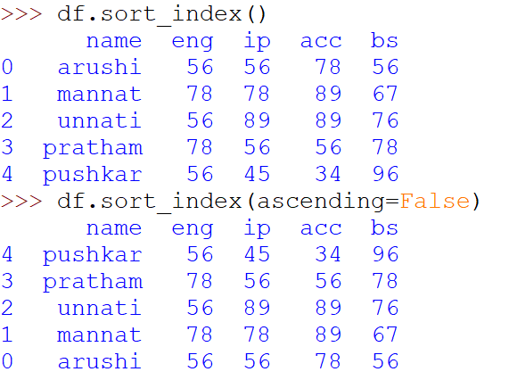
Sorting values on multiple column
Default is ascending order

Slide 22
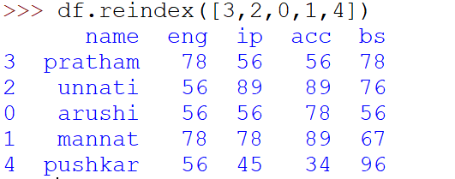
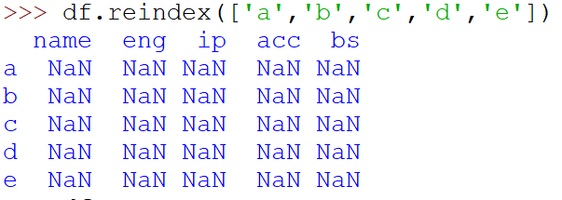
Reindex
Replace all existing value with NaN when trying to reindex with non-existant indexes

